Slide 1
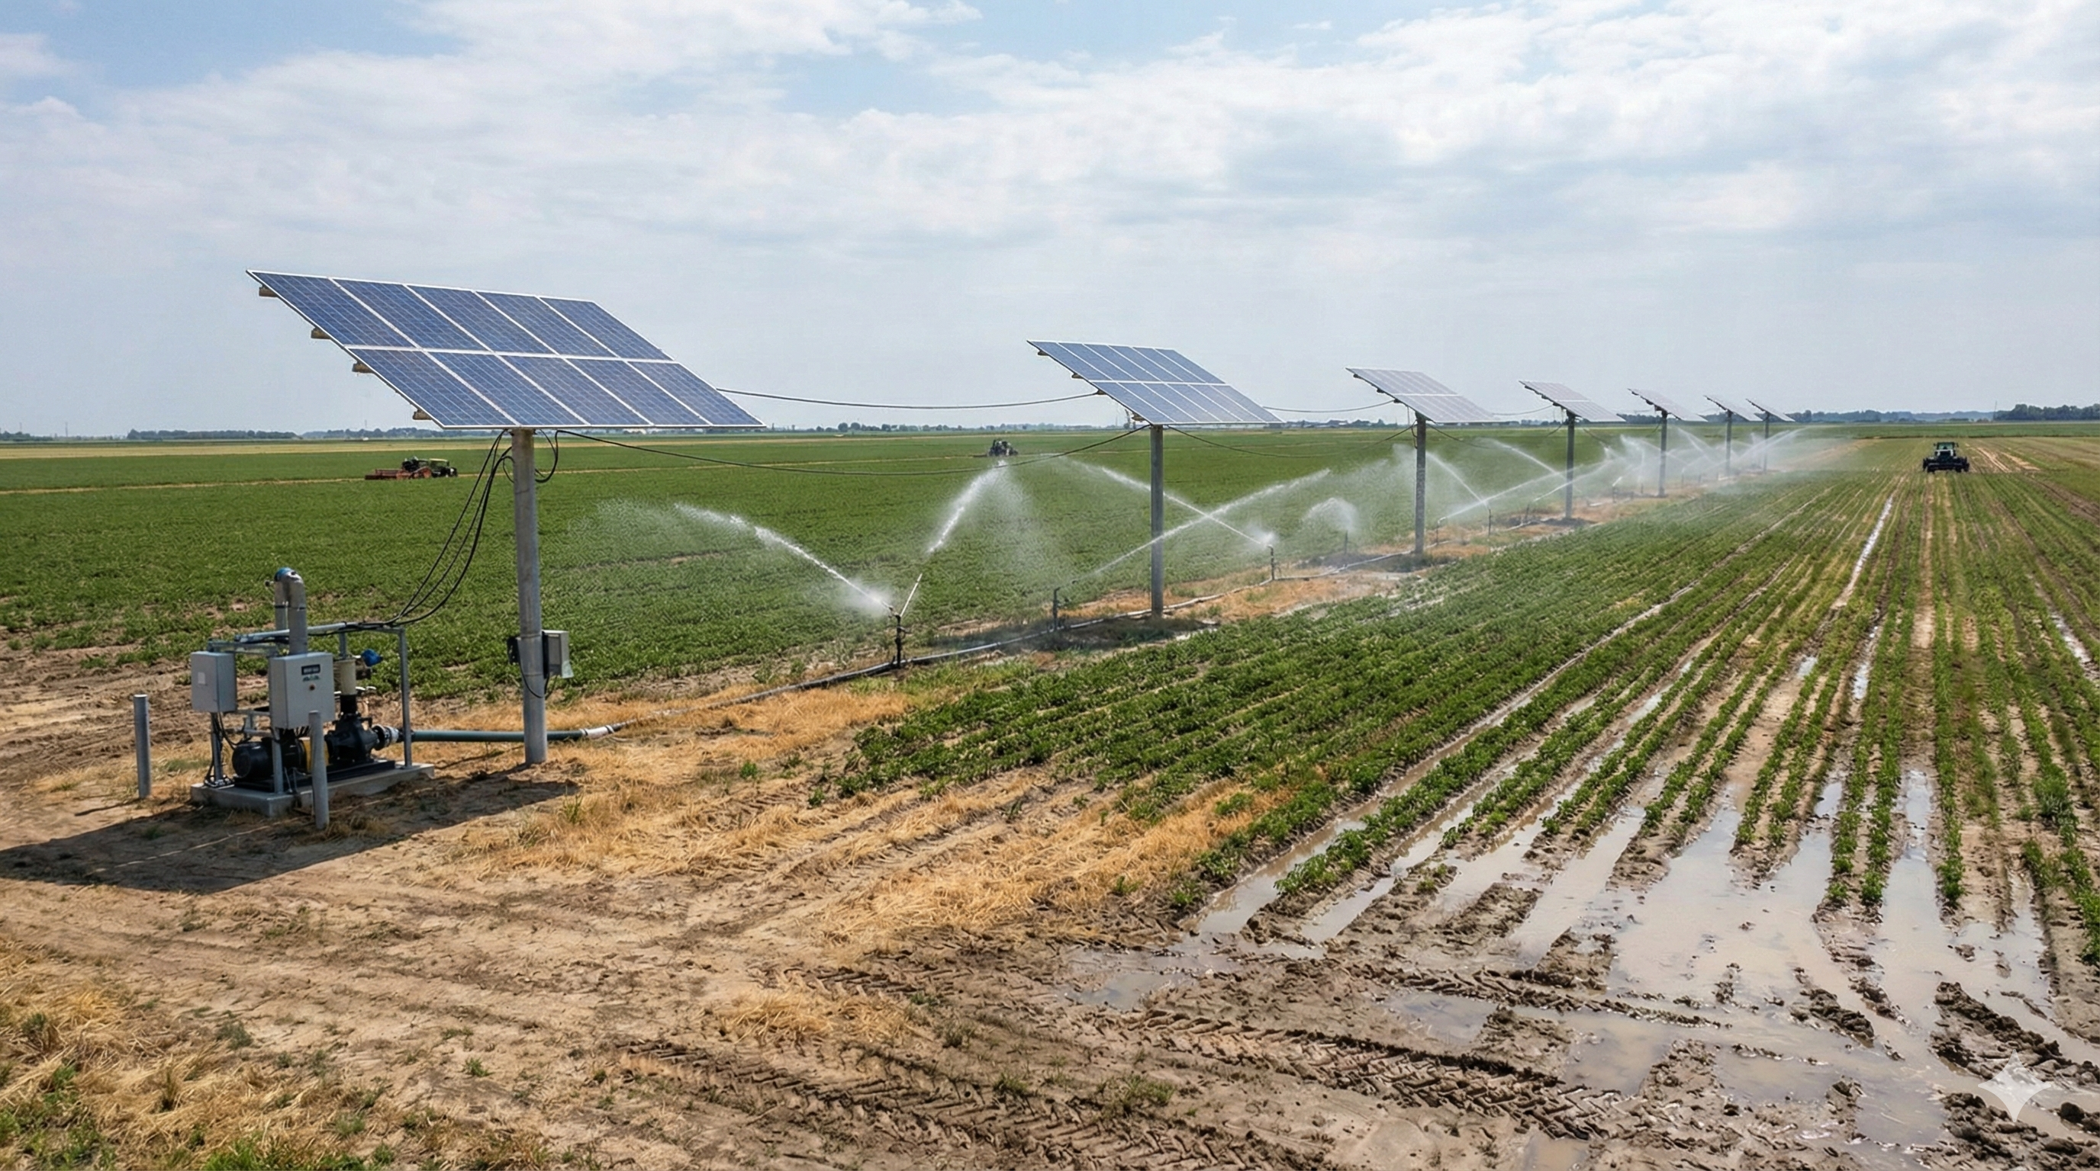
Predictive Adaptive Control for Solar-Powered Irrigation
MAE 506: Advanced Systems, Modelling and Control
Design, Simulation, and Comparative Analysis of Robust Disturbance Rejection Strategies
Team 15: Ankur Guruprasad, Anudeep Sai Gottapu,
Kapish Dubey, Yashwanth Gowda

Slide 2
Problem Statement
Agricultural irrigation pumps powered by solar energy must deliver constant water flow, but solar variations due to weather cause power and load fluctuations, leading to:
Reduced water supply during cloudy conditions
Energy inefficiency
Inconsistent agricultural output
Goal: Develop a control strategy (SISO System) that maintains constant water flow (15 L/min) under Sunny, Cloudy, and Overcast conditions using:
Standard PI Control
Predictive Feed-Forward PI Control
LQR (Optimal State-Space Control), and build the optimal controller.

Slide 3

System Overview
The Plant: Electromechanical DC Pump We modeled the system as a direct-coupled DC Motor driving a Centrifugal Pump.
Signal Flow (SISO Definition):
Control Input (u): Armature Voltage (0 - 24V).
Measured Output (y): Water Flow Rate (Q), derived directly from angular velocity.
Disturbance (d): External Load Torque ($τ$_{load}), representing hydraulic head pressure and pipe resistance.

Slide 4




Mathematical Modeling
The system dynamics are governed by two coupled physics domains:
Electrical Subsystem: Defined by the armature resistance (R) and inductance (L). This determines how fast the current (i) responds to Voltage inputs.
Mechanical Subsystem: Defined by the rotor inertia (J) and viscous friction (B). This determines how the motor speed ($ω$) responds to torque.
$$\text{Electrical} \text{Dynamics}$$
$$L\frac{di}{dt}+Ri+K_{e}ω=V$$
$$\text{Mechanical} \text{Dynamics}$$
$$J\frac{dω}{dt}+Bω=K_{t}i−τ_{d}$$
Variables:
$i$: Current (A)
$ω$: Angular Velocity (rad/s)
$τ$_{load}: External Load Torque (Disturbance)

Slide 5






State-Space Representation
$$x=\left[\begin{matrix}i \\ ω\end{matrix}\right], u=V, y=Q$$
$$A=\left[\begin{matrix}−\frac{R}{L} & −\frac{K_{e}}{L} \\ \frac{K_{t}}{J} & −\frac{B}{J}\end{matrix}\right], B=\left[\begin{matrix}\frac{1}{L} \\ 0\end{matrix}\right]$$
$$E=\left[\begin{matrix}0 \\ −\frac{1}{J}\end{matrix}\right]$$
$$y=Cx=K_{flow} ω$$
Let:
State-Space Equations:
$$x = A x + B u + E d$$
$$y = C x$$
System Matrices:
$$\text{Disturbance} \text{Input}\text{:}$$
$$A = \begin{matrix}−24 & −3 \\ 6.5 & −0.5\end{matrix}$$
$$\text{Output}\text{ (}\text{Flow} \text{Rate}\text{):}$$
B =
$$20$$
0

Slide 6
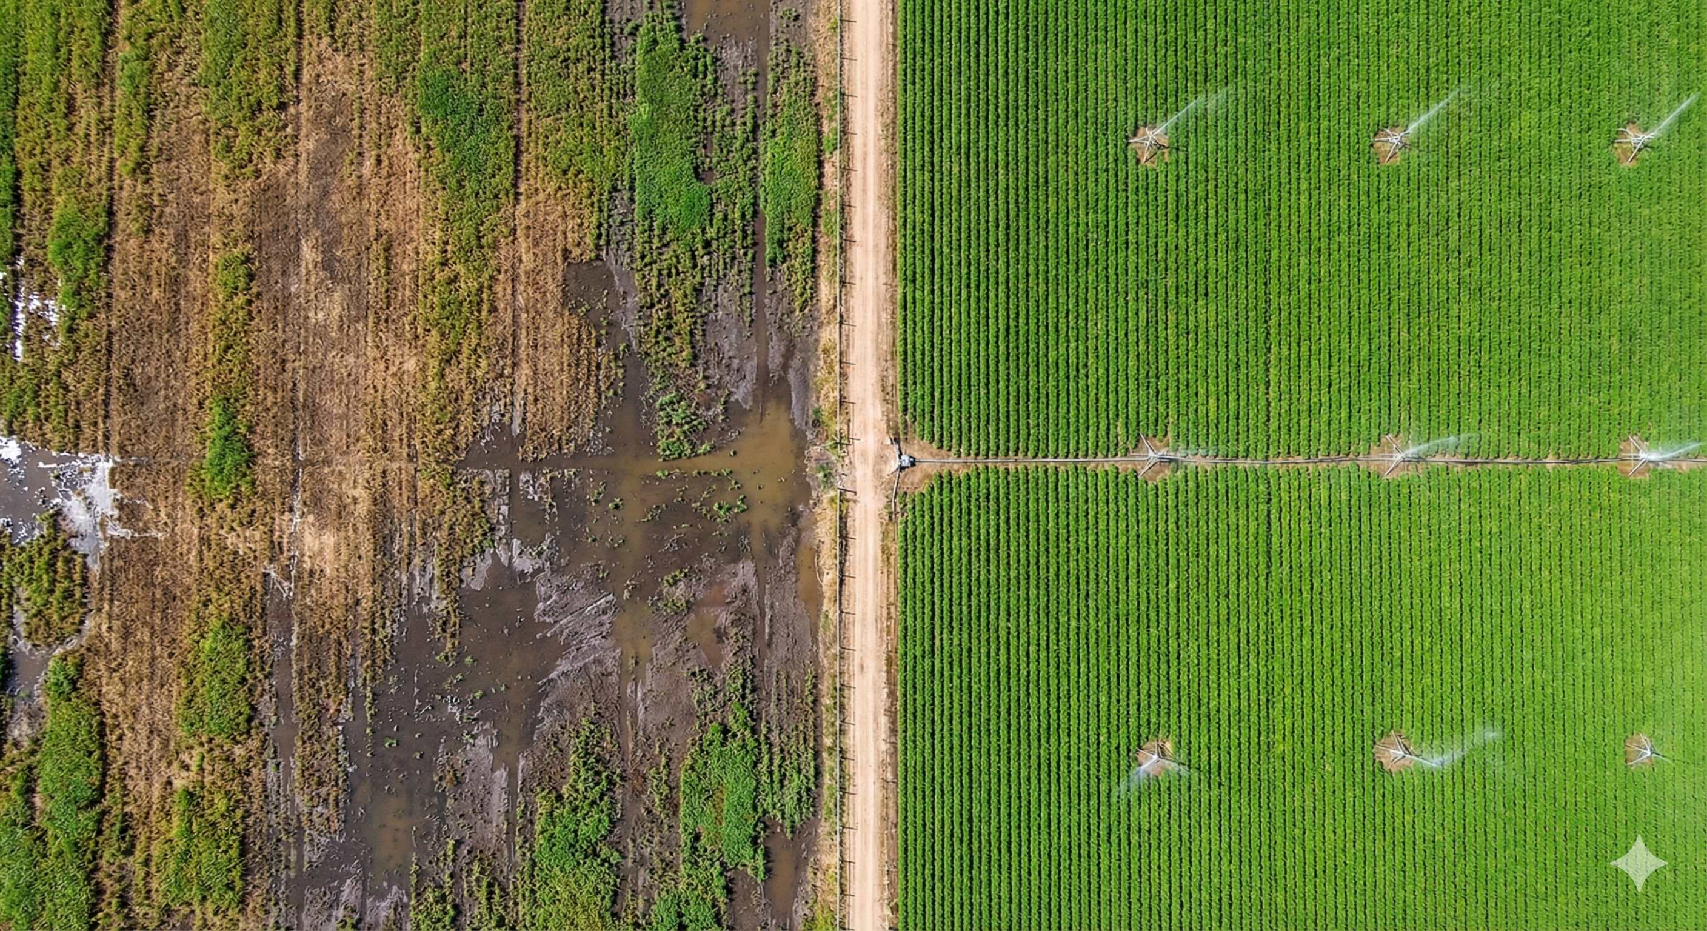
Stability Analysis
1. Stability:
Eigenvalues: (λ₁)= -23.13, (λ₂) = -1.39
Result: Stable (All poles in Left Half Plane).
2. Controllability:
Rank {C} = 2 (Full Rank)
Result: System is Fully Controllable.
3. Observability:
Rank {O} = 2 (Full Rank)
Result: System is Fully Observable.

Slide 7



System Analysis Calculations
Controllability Verification
Check if the input u can affect all states x.
Step 1: Form the Controllability Matrix C
Using {C} = [B AB]
C = [$\begin{matrix}20 & −480 \\ 0 & 130.5\end{matrix}$]
Observability Verification
Check if states x can be estimated from output y.
Step 1: Form the Observability Matrix O
Using {O} =[ $\begin{matrix}C \\ CA\end{matrix}$ ]
O = [ $\begin{matrix}0 & 3.5x10−6 \\ 2.28x10−5 & −1.82x10−6\end{matrix}$ ]
Step 2: Check Rank (Determinant)
det(O) = (0) - (3.5x10-6)(2.28x10-5) = -8.0x10-11 $≠$0
Conclusion: Rank = 2 (Full). The system is Fully Observable.
Step 2: Check Rank (Determinant)
Since the matrix is triangular, the determinant is the product of the diagonal:
det{C} = (20.0)(130.4) - 0 = 2608 $≠$ 0
Conclusion: Rank = 2 (Full). The system is Fully Controllable.

Slide 8
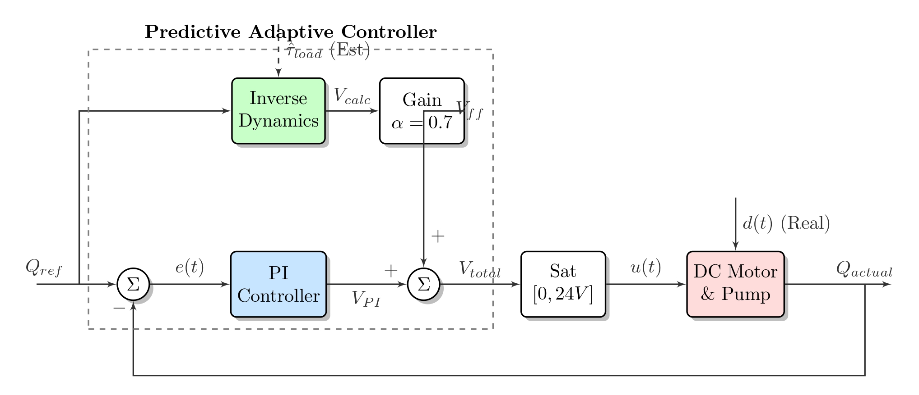
Control Architecture
Our system employs a Two-Degree-of-Freedom (2-DOF) hybrid architecture that splits the control effort into two parallel paths.
Simultaneously, the Feedback Path (Blue) acts as the "Corrector." It uses a standard PI controller to monitor the actual flow rate error.
If the physical parameters change (e.g., motor heating) or the feedforward model is slightly off, the PI loop creates a corrective signal to close the gap. By summing these two signals, we get the best of both worlds: the feedforward path rejects large disturbances immediately, while the feedback path ensures zero steady-state error.
The Feedforward Path (Green) acts as the "Predictor"; it uses the inverse physics model of the motor to calculate exactly how much voltage is theoretically needed to fight the estimated load torque and sustain the target speed. This allows the system to apply the necessary power instantly, before the pump even begins to slow down.

Slide 9
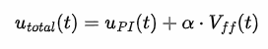
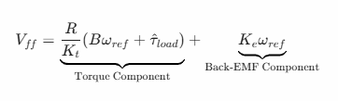
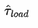

Controller Designs
Predictive Adaptive PI (Proposed Innovation)
Feedforward Term (V_{ff}):
Explanation:
Inverse Dynamics: We rearranged the motor's differential equations to solve for Voltage (V) assuming the system is at the target speed ($ω$_{ref}).
Disturbance Rejection: The term represents the estimated load. If the load spikes (clog), V_{ff} increases immediately to counteract it.
Scaler ($∝$): Set to 0.70 . This scales the feedforward kick to prevent overshooting the target during startup.

Slide 10
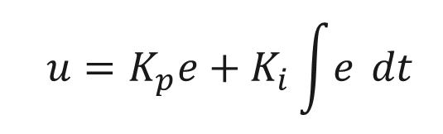
Controller Designs
Standard PI Controller
$$u=K_{p}e+K_{i}\int{e} dt$$
Objective: Eliminate steady-state error using classical error-tracking.
Explanation:
Proportional Term (K_{p}e): Reacts to the current error. Provides the immediate "push" toward the target.
Integral Term (K_{i}e): Sums up past errors. This term ramps up the voltage until the steady-state error is exactly zero.
Limitation: It is reactive. It cannot generate control effort until an error (e) actually occurs (i.e., after the pump has already slowed down).

Slide 11
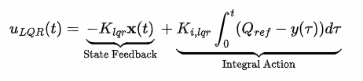
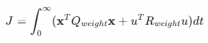

Controller Designs
Linear Quadratic Regulator (LQR) + Integral
Optimization Criteria (Cost Function): The gain vector K_{lqr} minimizes the cost function J:
Explanation:
State Feedback (-Kx): Uses the internal states (Current i and Speed $ω$) to stabilize the system dynamics.
Integral Action: Added to the standard LQR to ensure the flow rate tracks 15 L/min (Standard LQR regulates to zero).
Advantage: Mathematically guarantees stability margins

Slide 12
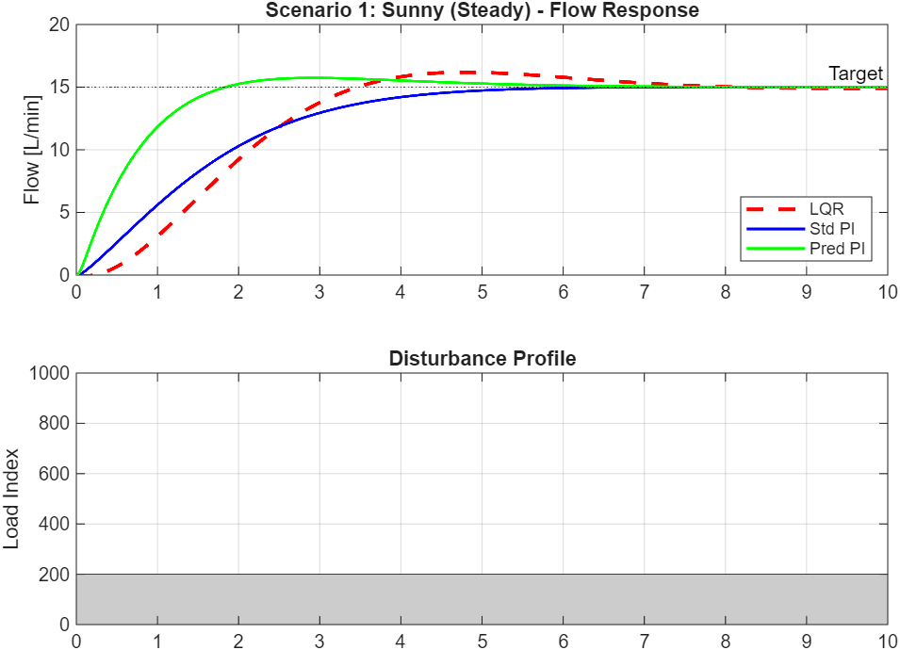
Results: Sunny Scenario
Sunny | LQR (State Space) | Standard PI | Predictive PI
Rise Time [s] | 2.2211 | 3.0276 | 1.1985
Overshoot [%] | 7.9034 | 0.0338 | 4.9182
Settling Time [s] | 7.0470 | 4.9038 | 4.9252

Slide 13
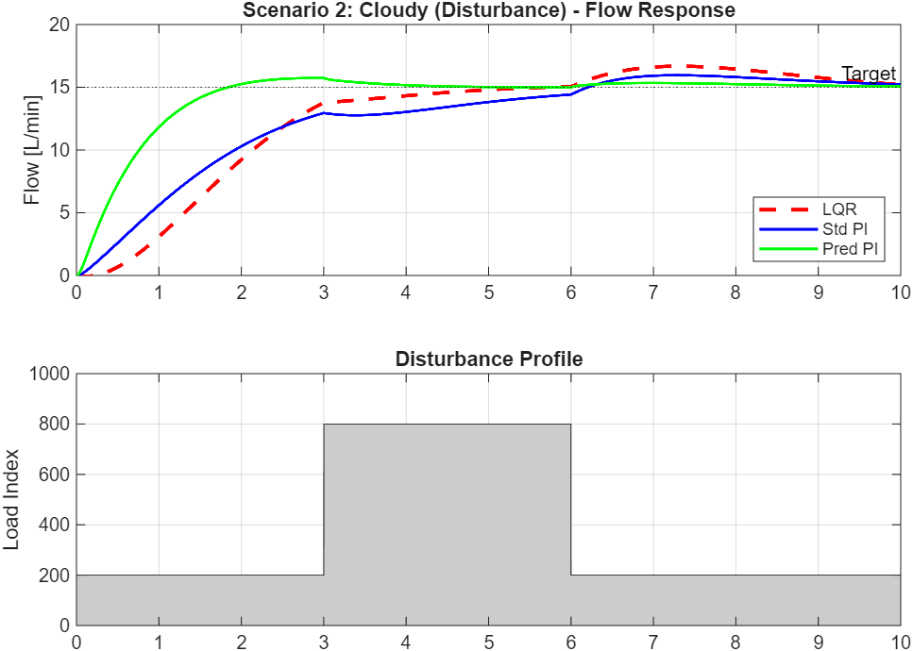
Results: Cloudy Scenario
Cloudy | LQR (State Space) | Standard PI | Predictive PI
Rise Time [s] | 2.2211 | 4.2672 | 1.1985
Overshoot [%] | 11.1933 | 6.3963 | 4.9182
Settling Time [s] | 9.8131 | 9.6563 | 7.6041

Slide 14
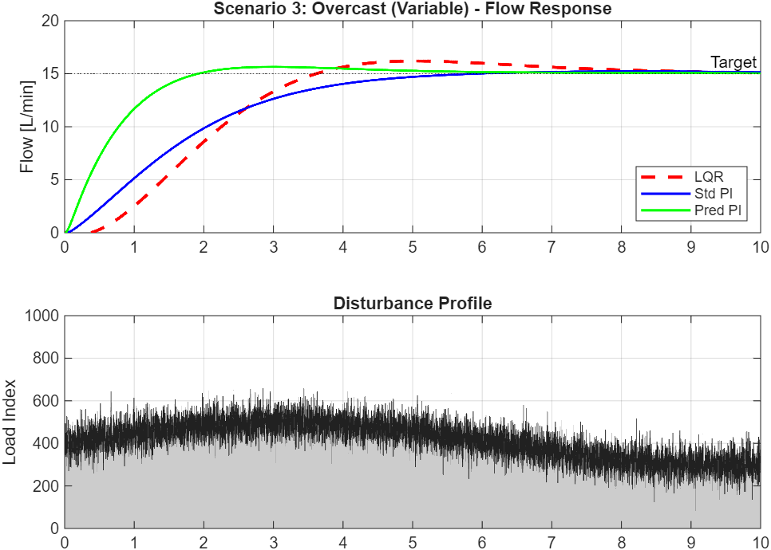
Results: Overcast Scenario
Overcast | LQR (State Space) | Standard PI | Predictive PI
Rise Time [s] | 2.2488 | 3.1671 | 1.2307
Overshoot [%] | 8.0223 | 1.5458 | 4.3149
Settling Time [s] | 8.3223 | 4.9843 | 4.8770

Slide 15

Advantages & Disadvantages
1. Linear Quadratic Regulator (LQR)
Disadvantages:
Reactive Nature: As a feedback controller, it cannot react until the states (i,$ω$) deviate from the target. It is always "playing catch-up."
Sensing Requirements: Requires Full State Feedback. You must measure both Motor Current (i) and Rotor Speed ($ω$). Standard PI only requires flow measurement.
Steady-State Error: Standard LQR regulates states to zero. To track a reference (15 L/min), we had to artificially add an Integral state (K_{i}), increasing complexity.
Advantages:
Guaranteed Stability: LQR guarantees infinite gain margin and 60° phase margin for SISO systems. It is mathematically "safe."
Systematic Design: You don't "guess" gains (K_{p}, K_{i}). You tune the Cost Function (Q and R) based on physics (energy vs. performance), and the math gives you the optimal K.
Energy Optimization: Because of the u^{T} Ru term in the cost function, LQR naturally avoids excessive voltage spikes if tuned correctly.

Slide 16
Advantages & Disadvantages
2. Predictive Adaptive PI
Advantages:
Proactive Disturbance Rejection: By using the Feedforward term (V_{ff}), it cancels out pressure spikes before they slow down the motor.
Speed: It uses the physics model (Inverse Dynamics) to jump instantly to the required voltage, resulting in a 60% faster Rise Time.
Simplicity: It does not require full state feedback vectors or matrix operations. It is a simple algebraic calculation added to a standard PI loop
Disadvantages:
Model Sensitivity: It relies on knowing R, L, K_{t}, J. If the motor gets old or heats up (changing R), the "prediction" becomes slightly wrong (though the PI part usually fixes this).
Noise Sensitivity: Feedforward terms can sometimes amplify sensor noise if not filtered correctly.

Slide 17
The "Proof" Table: Why Predictive PI Wins
Feature | LQR (State Space) | Predictive PI (Proposed) | Winner
Control Logic | Feedback (Reactive) | Feedforward + Feedback (Proactive) | Predictive
Rise Time | 2.22 seconds | 1.20 seconds | Predictive
Overshoot | 7.9% | 4.9% | Predictive
Response to Clog | Slow recovery (Curve) | Instant recovery (Flat) | Predictive
Stability Guarantee | Mathematically Proven | Empirical (Pole placement) | LQR
Sensor Needs | High (Current + Speed) | Moderate (Flow + Load Est) | Predictive
Suitability | Unstable Systems (Inverted Pendulum) | Load-Heavy Systems (Pumps) | Predictive

Slide 18
Future Improvements
1. Hardware Implementation (The "Real World" Step) : Currently, our results are based on a MATLAB simulation. The immediate next step is to validate this on a physical test rig.
2. Adaptive Parameter Estimation (The "AI" Step): Our Predictive Controller relies on knowing parameters like Resistance (R) and Friction (B). In reality, these change as the motor heats up or the bearings wear out.“
3. Energy Optimization: We optimized for Flow Accuracy. A commercial farm might care more about Efficiency.

Slide 19
Final Conclusion
A robust solar irrigation pump control system was developed.
Ensures constant 15 L/min water flow, improves efficiency, and enables sustainable agriculture.
If we were controlling an unstable system like a rocket or a Segway, LQR would be the winner because stability is the only thing that matters.
But we are controlling a water pump. The pump is naturally stable, but it faces massive external forces (pressure).
Therefore, Predictive PI is the superior choice. It doesn't waste time 'stabilizing' a stable plant; instead, it focuses purely on fighting the enemy (the load disturbance).

Slide 20
References
R. L. Williams II and D. A. Lawrence, Linear State-Space Control Systems. Hoboken, NJ: John Wiley & Sons, 2007: State-space modeling, Controllability/Observability matrices, and LQR design.
N. S. Nise, Control Systems Engineering, 7th ed. New York, NY: John Wiley & Sons, 2014: C Motor physical modeling equations (Kirchhoff's/Newton's laws) and Standard PI tuning.
K. Ogata, Modern Control Engineering, 5th ed. Upper Saddle River, NJ: Prentice Hall, 2010: Detailed stability analysis and pole placement theory.

Slide 21
THANK YOU
Any Questions?

